Slide 1
A01 - Charts
Write text here

Slide 2
Program
Charts explained
Create your own charts
What else could you do

Slide 3
Preparation
Create Data Tables
Create a Spark Line
Create a Chart

Slide 4
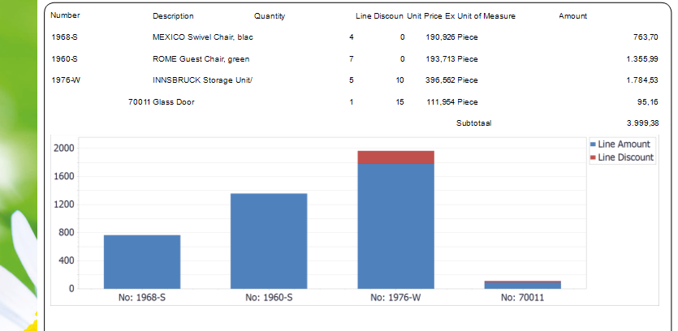
Execution
Add a chart on the Sales Invoice that displays the line amount and line discount amount.

Slide 5
Reflection
Where else can we use charts?

